Slide 1


PYTHON
Lecture 15

Slide 2

Today’s Agenda
Input Function And Math Module In Python
Using the input( ) Function
Using the math module
Different ways of importing a module
Accepting multiple values in single line

Slide 3
Accepting Input In Python
To accept user input , Python provides us a function called input ( )
Syntax:
input([prompt])
The input() function takes a single optional argument , which is the string to be displayed on console.

Slide 4
Return Value Of input( )
The input() function reads a line from keyboard , converts the line into a string by removing the trailing newline, and returns it.

Slide 5

Example 1 (Using input() without message)
print("enter your name")
name=input()
print("Hello",name)
Output:

Slide 6

Example 2 (Using input( ) With Message)
name=input("enter your name")
print("Hello",name)
Output:

Slide 7
Example 3 (Using input( ) With Message)
name=input(“Enter your full name:”)
print("Hello",name)
Output:

Slide 8
Accepting Integer Input
By default the function input( ) returns the inputted value as a string
So , even if we input a numeric value , still Python considers it to be string

Slide 9
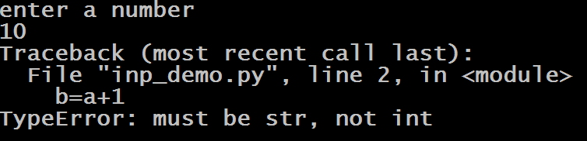
Accepting Integer Input
To understand this behavior , consider the following code:
a=input("enter a number\n")
b=a+1
print(b)
Output:

Slide 10
Accepting Integer Input
To solve this , we can use Type Conversion Functions in Python , for converting a given value from string to other type.
For example , in the previous code , we can use the function int( ) to convert string value to integer

Slide 11
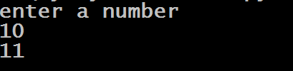
Accepting Integer Input
a=input("enter a number\n")
b=int(a)+1
print(b)
OR
a=int(input("enter a number\n")
b=a+1
print(b)

Slide 12
Accepting Float And Bool
For converting input values to float and boolean we can call float( ) and bool( ) functions
Example:
s=input("enter your percentage\n")
per=float(s)
print(per)
OR
s=input(“Delete the file ?(yes-True,no-False)")
ans=bool(s)
print(ans)

Slide 13
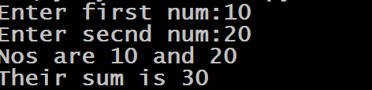
Exercise
WAP to accept two numbers from the user and display their sum
Code:
a=int(input("Enter first num:"))
b=int(input("Enter secnd num:"))
c=a+b
print("Nos are",a,"and",b)
print("Their sum is",c)

Slide 14

Exercise
Can you write the previous code in one line only ?
Code:
print("Their sum is",int(input("Enter first num:"))+int(input("Enter secnd num:")))

Slide 15

Exercise
WAP to accept radius of a Circle from the user and calculate area and circumference
Code:
radius=float(input("Enter radius:"))
area=3.14*radius**2
circum=2*3.14*radius
print("Area is",area)
print("Circumference is",circum)

Slide 16
Exploring More About math Module
We have already discussed that Python has a module called math .
This module helps us perform mathematical calculations
It contains several mathematical constants and functions

Slide 17
Exploring More About math Module
Following are some important functions :
math.factorial(x)
math.floor(x)
math.ceil(x)
math.gcd(a, b)
math.pow(x,y)
math.sqrt(x)
Following are it’s important mathematical constants:
math.pi : The mathematical constant π = 3.141592…
math.e: The mathematical constant e = 2.718281…,
math.tau: Tau is a circle constant equal to 2π

Slide 18
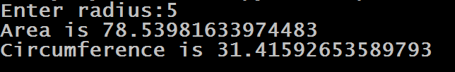
Modified Version Of Previous Code Using math Module
Code:
import math
radius=float(input("Enter radius:"))
area=math.pi*math.pow(radius,2)
circum=math.tau*radius
print("Area is",area)
print("Circumference is",circum)

Slide 19
Second Way To Import A Module
We can use aliasing for module names
To do this , Python provides us as keyword
Syntax:
import modname as newname
This helps us to use short names for modules and make them more easy to use

Slide 20
Using as Keyword
Code
import platform as p
print(p.system())

Slide 21
Second Way Of Writing Previous Code Using math Module
Code:
import math as m
radius=float(input("Enter radius:"))
area=m.pi*m.pow(radius,2)
circum=m.tau*radius
print("Area is",area)
print("Circumference is",circum)

Slide 22
Third Way To Import A Module
We can also import specific members of a module
To do this , Python provides us from keyword
Syntax:
from modname import name1[, name2[, ... nameN]]
In this way we will not have to prefix the module name before the member name while accessing it

Slide 23

Using from Keyword
Code
from sys import getsizeof
a=10
b=“hello”
print(getsizeof(a))
print(getsizeof(b))

Slide 24
Third Way Of Writing Previous Code Using math Module
Code:
from math import pi,tau,pow
radius=float(input("Enter radius:"))
area=pi*pow(radius,2)
circum=tau*radius
print("Area is",area)
print("Circumference is",circum)

Slide 25
Fourth Way To Import A Module
It is also possible to import all names from a module into the current file by using the wildcard character *
Syntax:
from modname import *
This provides an easy way to import all the items from a module into the current file

Slide 26
Using WildCard Character
Code
from sys import *
a=10
b=“hello”
print(getsizeof(a))
print(getsizeof(b))

Slide 27
Fourth Way Of Writing Previous Code Using math Module
Code:
from math import *
radius=float(input("Enter radius:"))
area=pi*pow(radius,2)
circum=tau*radius
print("Area is",area)
print("Circumference is",circum)

Slide 28
How To List All Members Of A Module
In Python , we can print members of a module in the Python Shell window
This can be done in 2 ways:
By calling the dir( ) function passing it the module name
By calling the help( ) function passing it the module name

Slide 29
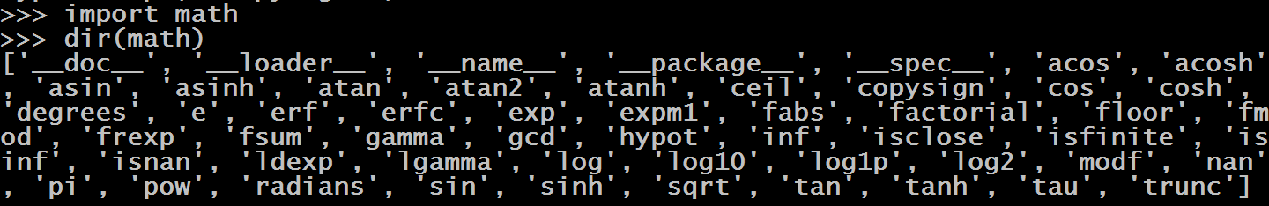
Using dir( )
The dir( ) function accepts the name of a module as argument and returns a list of all it’s members.
However the module must be imported before passing it to the dir( ) function

Slide 30
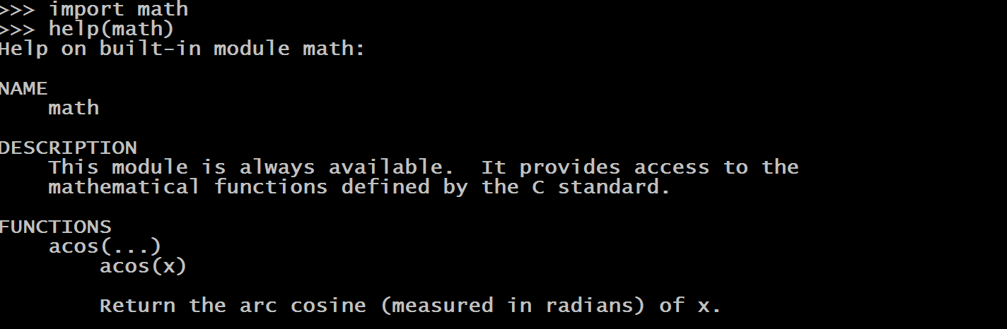
Using help( )
The help( ) function accepts the name of a module as argument and displays complete documentation of all the members of the module
Here also , module must be imported before using it.

Slide 31
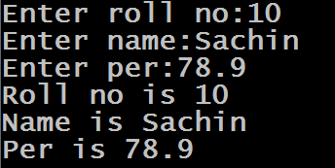
Accepting Different Values
WAP to accept roll number , grade and percentage as input from the user and display it back
Code
roll=int(input("Enter roll no:"))
name=input("Enter name:");
per=float(input("Enter per:"))
print("Roll no is",roll)
print("Name is",name)
print("Per is",per)

Slide 32
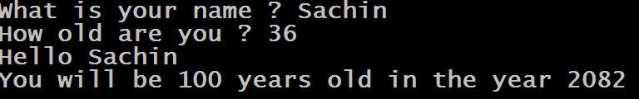
Exercise
Write a program that asks the user to enter his/her name and age. Print out a message , displaying the user’s name along with the year in which they will turn 100 years old.

Slide 33
Accepting Multiple Values In One Line
In Python , the input( ) function can read and return a complete line of input as a string.
However , we can split this input string into individual values by using the function split( ) available in the class str
The function split( ) , breaks a string into multiple strings by using space as a separator

Slide 34
Accepting Multiple Values In One Line
To understand , working of split( ) , consider the following example:
text=“I Love You”
word1,word2,word3=text.split()
print(word1)
print(word2)
print(word3)
Output:
I
Love
You

Slide 35
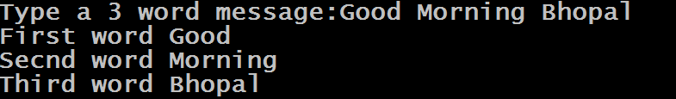
Accepting Multiple Values In One Line
text=input(“Type a 3 word message”)
word1,word2,word3=text.split()
print(“First word”,word1)
print(“Secnd word”,word2)
print(“Third word”,word3)
Output:

Slide 36
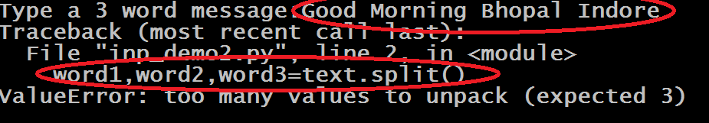
An Important Point!
The number of variables on left of assignment operator and number of values generated by split() must be the same

Slide 37
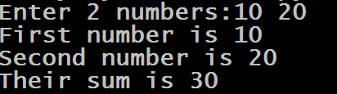
Exercise
Write a program that asks the user to input 2 integers and adds them . Accept both the numbers in a single line only

Slide 38
Solution
Code:
s=input("Enter 2 numbers:")
a,b=s.split()
print("First number is",a);
print("Second number is",b)
c=int(a)+int(b)
print("Their sum is",c)

Slide 39
Accepting Multiple Values Separated With ,
By default split( ) function considers , space as a separator
However , we can use any other symbol also as a separator if we pass that symbol as argument to split( ) function
For example , if we use comma , as a separator then we can provide comma separated input

Slide 40
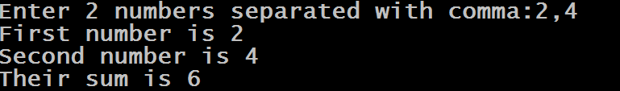
Example
Code:
s=input("Enter 2 numbers separated with comma:")
a,b=s.split(",")
print("First number is",a);
print("Second number is",b)
c=int(a)+int(b)
print("Their sum is",c)

Slide 41
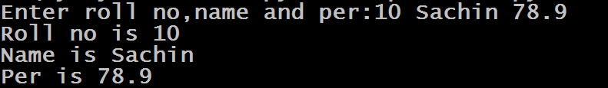
Accepting Different Values In One Line
Code:
s=input("Enter roll no,name and per:")
roll,name,per=s.split()
print("Roll no is",roll)
print("Name is",name)
print("Per is",per)

